Slide 1
Extreme Experience in New York City
IBM Data Science Capstone Project
Maojie Gong
Email: gongmj2000@gmail.com

Slide 2
Business Problems for Current Tourism
Customer satisfaction issue for fixed schedule tourist group
Time and visit places to visit fixed
No or little flexibility for personal arrangement
Places normally famous but expensive and too hot with too many people
With low customer satisfaction generally speaking
Don’t know where to go for flexible individual tourist
Not familiar with New York city as mainly from other countries or states
Just know few famous places like “Statue of Liberty” and “Empire State Building” etc.
Flexible but don’t know the good places to visit
Can we dig out and recommend some places with top customer experience for
travel corporation/agency and tourist's selection?

Slide 3
Solution Proposal and Methodology – Travel Recommendation List with Top Customer Experience
Use history customer rating data for venue selection
Define categories based on tourists' interest(Hotel, Museum, Restaurant etc.)
Select only top venue with excellent top customer feedback rating and experience for each category
Consolidate venues with location information from all selected categories
Venue segmentation with Machine Learning clustering algorithms based on venue location data so that each segment is mapped to one day trip arrangement
Travel corporation/agency or tourist can choose from recommendation list for their travel trip arrangement
Foursquare location and historic customer rating data will be used
as basis for venue selection

Slide 4
Data Used
Venue search data: Venue name, ID, Location and category
Venue explore data: Venue Name, ID, Tips, URL, Location, Rating, Statistics, Contact Info
Tips data: Can be used on top of venue rating to enhance venue selection accuracy, but will not be used for this Capstone project
User data: Will not be used for this project
Critical Data for the project:
Venue category
Venue ID
Venue location
Venue rating

Slide 5
Major Process
Limit the data to Manhattan and surrounding area as show case
Define major categories for travel arrangement based on typical tourists’ interest
Select one central location in Manhattan as starting point
Select max 50 venues for each category around the selected venue
Collect rating for each venue and then select Top 10 venues with highest rating score for each category.
Combine all the venues for all selected categories and get the venue list with location data
Use K-means algorithm or other clustering algorithms to divide the venues into K segments/clusters based on location data

Slide 6
Example: Consolidation of Venue List
Rank | Hotel
1 | Hotel 1
2 | Hotel 2
3 | Hotel 3
10 | Hotel 10
Rank | Museum
1 | Museum 1
2 | Museum 2
3 | Museum 3
10 | Museum 10
Rank | Restaurant
1 | Restaurant 1
2 | Restaurant 2
3 | Restaurant 3
10 | Restaurant10
… …

Slide 7



Example: Venue Segmentation/Clustering

Slide 8
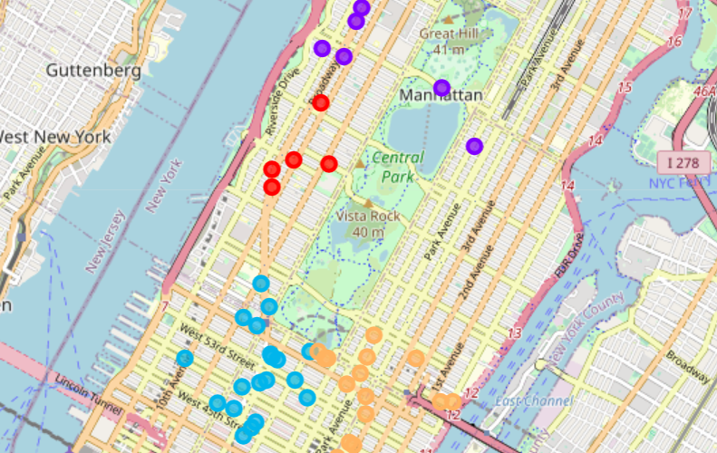
Results: Clustering Visualization

Slide 9
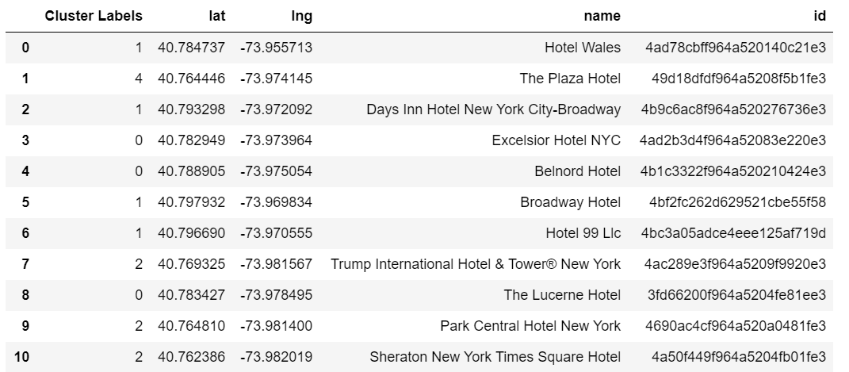
Results: Clustering List

Slide 10
Conclusion
The solution proposal, methodology and process verified feasible
This project is successful as PoC project
Only some basic data used due to license and time limitation
More accurate venue election can be achieved with more data used
This can be discussed with Travel Corporation/Agency for
comments and for possible cooperation

Slide 11
Discussion and Proposal
This is just simplified project to show the feasibility and real project can be much more complicated with more info added
Tips and user data not used for the project, but these data can be used to enhance venue selection accuracy on top of venue data
There can be different business models with results
Travel corporation/agency for travel trip planning
Recommendation to individual tourist
Other approach

